Slide 1
Report on CVPR(Computer Vision and Pattern Recognition) 2017
SCRL
Yangxing LIU
08.10.2017

Slide 2
Roadmap
Overview
Hot research topics in machine learning
Interesting paper & technology
Hand gesture recognition
One shot learning
Face related
Action prediction

Slide 3

CVPR2017
Conference(July. 21-July. 26)
2620 paper submissions
783 (22%↑)papers accepted
(29.9% of 2620)
215 long and short(Spotlights) oral
presentations
More than 5000 Attendants
Three tracks
127 sponsors

Slide 4
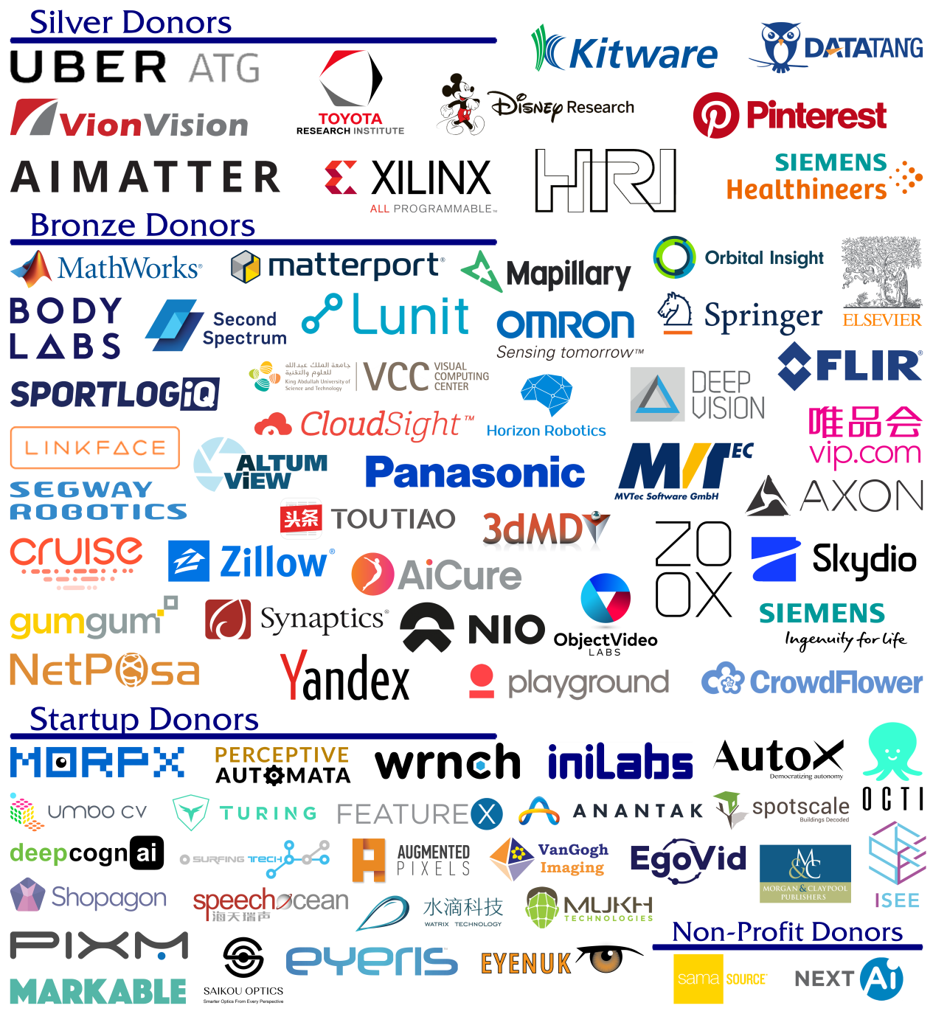
CVPR2017
Conference(July. 21-July. 26)
2620 paper submissions
783 (22%↑)papers accepted
(29.9% of 2620)
215 long and short(Spotlights) oral
presentations
More than 5000 Attendants
Three tracks
127 sponsors

Slide 5
One trend in AI
More and more companies are creating their own AI processor
Apple is said to be secretly developing a dedicated AI chip for the iPhone
Google
Facebook
Nvidia
Intel
IBM(TrueNorth)
Microsoft
The next version of Hololens will be equipped with an AI coprocessor

Slide 6
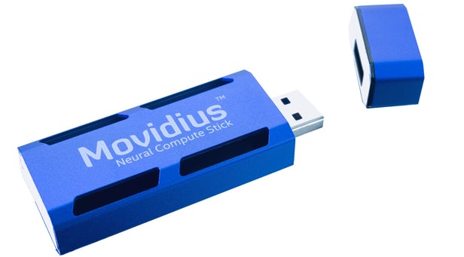
News from industry
Microsoft 2nd Generation Hololens
Microsoft announced in CPVR2017 that the next version of its Hololens will be equipped with an AI coprocessor to allow Hololens to analyze data without needing to use the cloud.
Intel Neural Compute Stick
A development kit for ultra low power embedded deep neutral networks with a processing unit sitting on a USB3 stick and is linear scalable to 5 to 10 sticks depending on application.
Support Caffe only.
Very popular and sold out quickly in CVPR2017

Slide 7
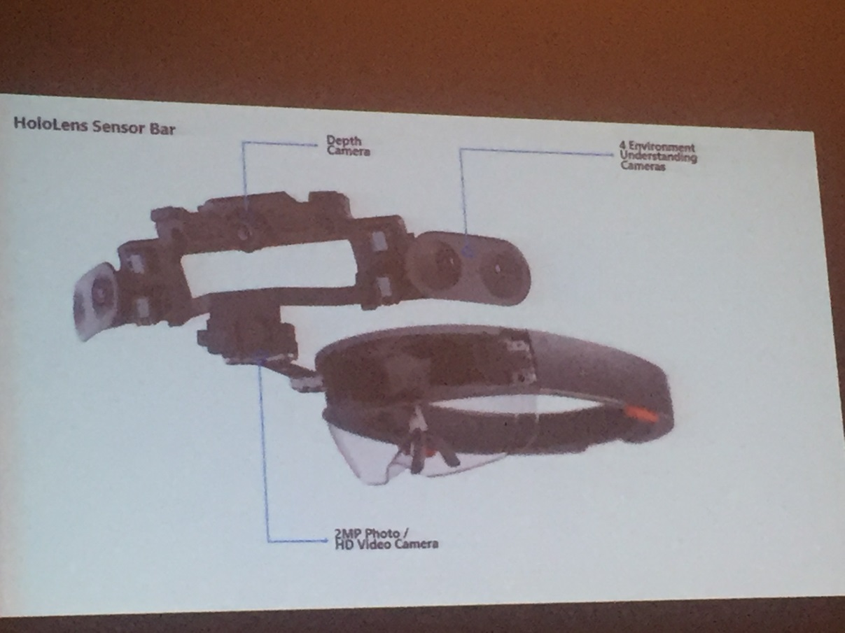
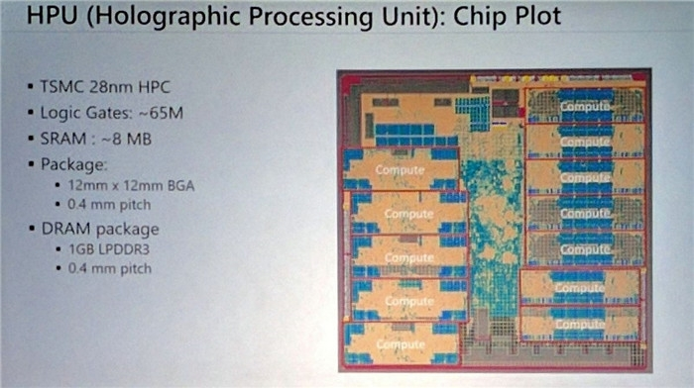
Hololens
Hardware
HPU、2 See-through holographic lenses、2 Micro display、6cameras

Slide 8
Two hot research topics in machine learning
Generative adversarial networks(GANs)
Unsupervised learning
Composed of two networks, adversarial & generator network
Deep residual network
Won best paper in CVPR2016
Achieved lower training and test error with deeper network

Slide 9
Awards
best paper award
Densely Connected Convolutional Networks, Gao Huang, Zhuang Liu, Laurens van der Maaten, & Kilian Q. Weinberger(from Cornell & Tsinghua Univ.)
DenseNet, an improvement upon ResNet by adding dense skip connections
Learning from Simulated and Unsupervised Images through Adversarial Training, Ashish Shrivastava, Tomas Pfister, Oncel Tuzel, Joshua Susskind, Wenda Wang, & Russell Webb(from Apple)

Slide 10
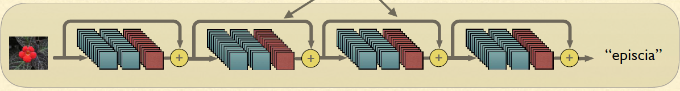
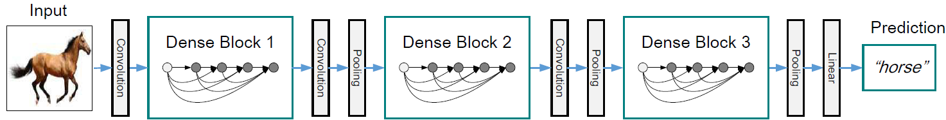
Densely Connected Convolutional Networks
best paper award
DenseNet, an improvement upon ResNet by adding dense skip connections
Previous residual net
Residual block
Dense net

Slide 11
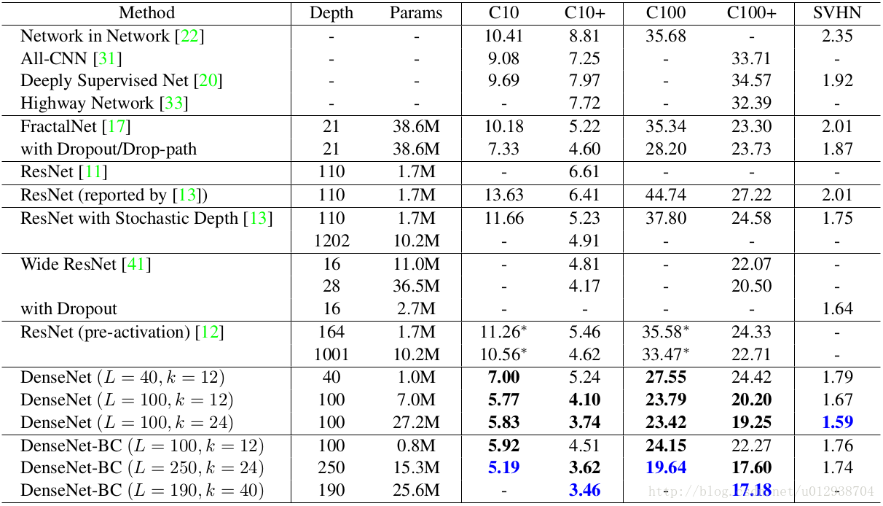
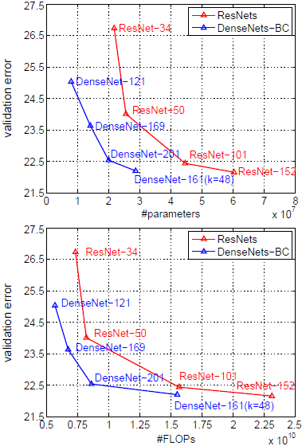
Densely Connected Convolutional Networks
best paper award
DenseNet, an improvement upon ResNet by adding dense skip connections
Results on Imagenet

Slide 12
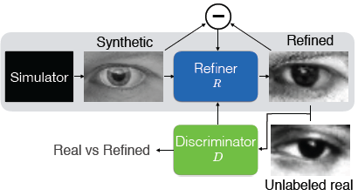
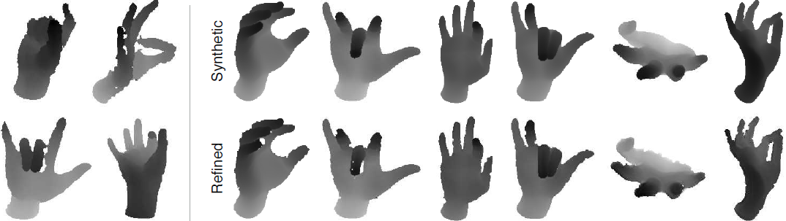
Learning from Simulated and Unsupervised Images through Adversarial Training
best paper award
Apple’s first AI paper.
Propose S+U learning that uses unlabeled real data to refine the synthetic images.
Basically a conditional GAN with some extra regularization.
Overview of SimGAN.

Slide 13
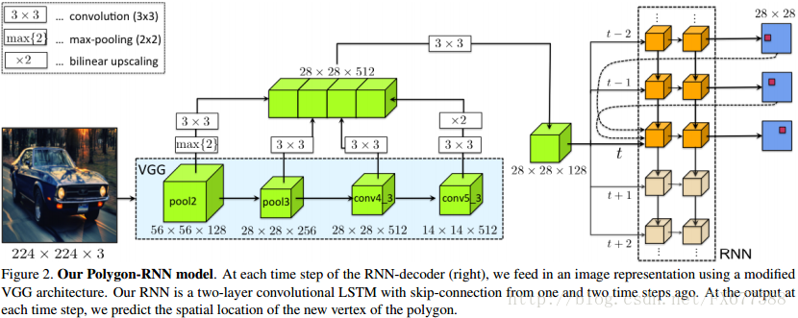
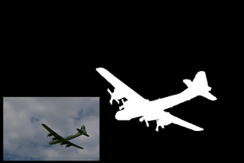
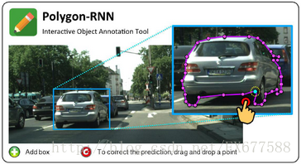
Awards
best paper Honorable Mention Awards
Annotating Object Instances with a Polygon-RNN, Lluís Castrejón, Kaustav Kundu, Raquel Urtasun, & Sanja Fidler (from Univ. of Toronto)
Propose an approach for semi-automatic annotation of object instances
Predict a vertex with a two-layer ConvLSTM, which inputs with CNN representation of the image crop, the vertices predicted one and two time steps ago, plus the first point.
Pixel-labeling time consuming

Slide 14
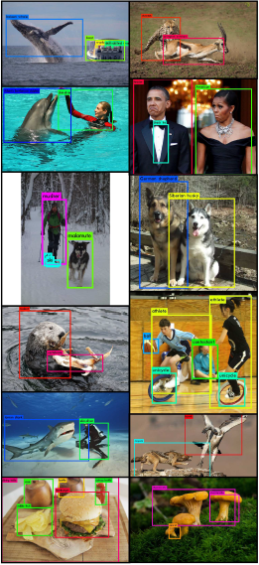
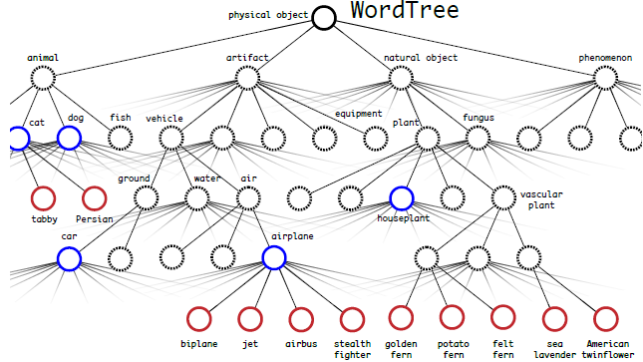
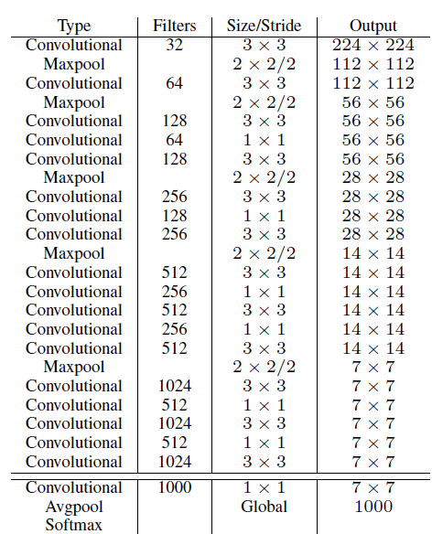
Awards
best paper Honorable Mention Awards
YOLO9000: Better, Faster, Stronger, Joseph Redmon & Ali Farhadi (from Univ. of Washington)
Propose a real-time framework for detection more than 9000 object categories
Trained using a special new technique of training simultaneously on both detection and classification data.
Final model, Darknet-19

Slide 15
Hand gesture recognition

Slide 16
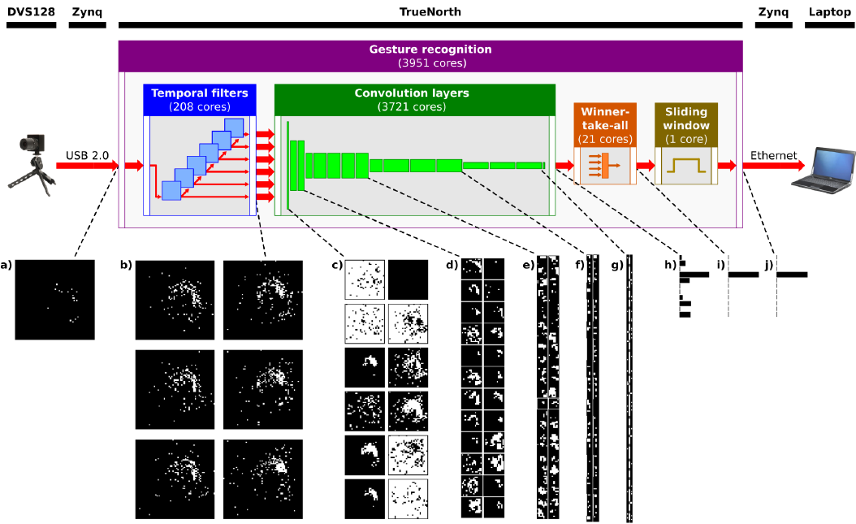
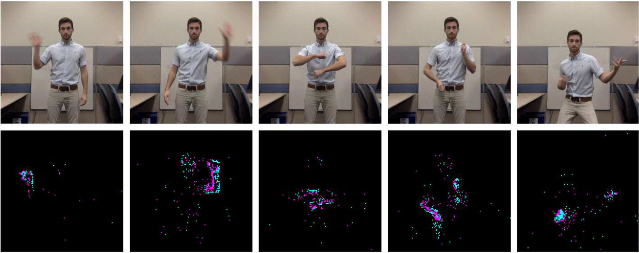
A Low Power, Fully Event-Based Gesture Recognition System, from IBM
Use iniLabs DVS128(Dynamic Vision Sensor) sensor
CNN running on an asynchronous, low-power, event-based neuromorphic processor
RGB data
DVS data
Gesture recognition network model

Slide 17
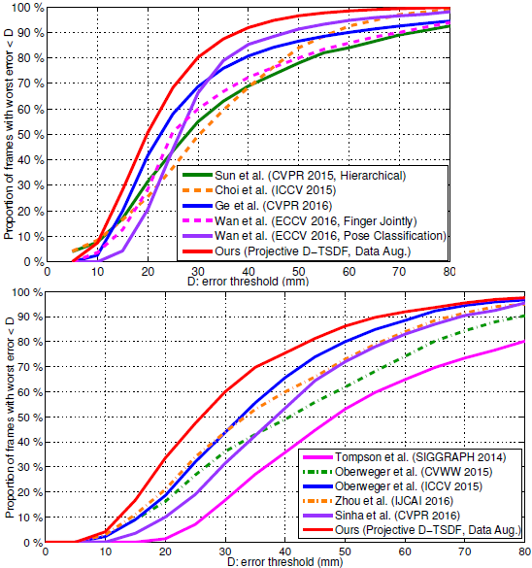
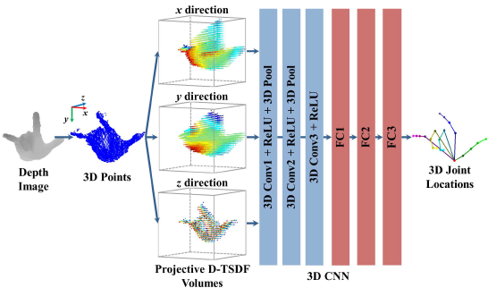
3D convolutional neural networks for efficient and robust hand pose estimation from single depth images, from Nanyang Tech. Univ.
Propose a novel 3D CNN based hand pose estimation method
By adopting the projective D-TSDF, encode the hand depth image as a 3D volumetric representation which is then fed into the 3D CNN.
Results on MSRA dataset
(21 hand joints)
Results on NYU dataset
(14 hand joints)
Overview of proposed method

Slide 18
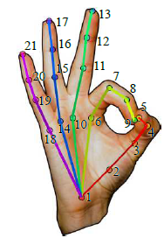
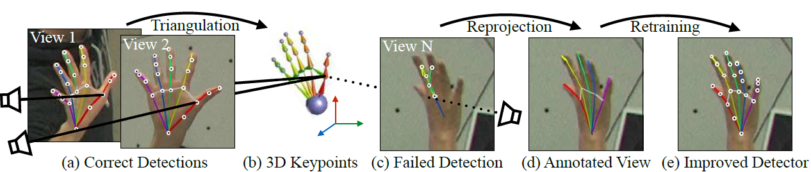
Hand Keypoint Detection in Single Images Using Multiview Bootstrapping, from CMU
A novel method is proposed to train a hand keypoint detector for single images
The resulting keypoint detector runs in real-time on RGB images
Keypoint detection algorithm is based on CPM, CVPR2016
21 key points
Multiview Bootstrapping for training

Slide 19
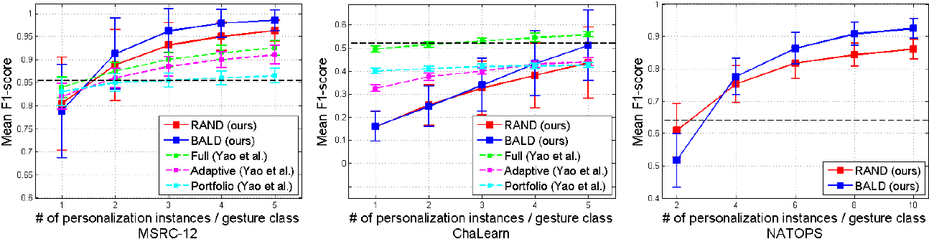
Personalizing Gesture Recognition Using Hierarchical Bayesian Neural Networks, from Boston Univ. & IBM
The main technical innovation lies in the use of data efficient Bayesian neural networks, which can learn from very few labeled examples as well as guide interactive labeling of unlabeled gestures.
The dashed black line represents nonpersonalized baseline, trained with data from all subjects except the test (personalization) subject pooled together.

Slide 20
One-shot learning

Slide 21
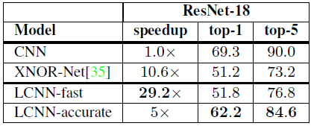
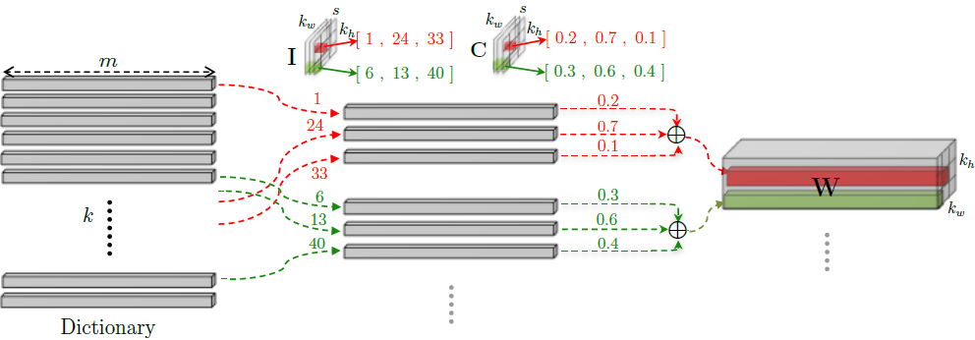
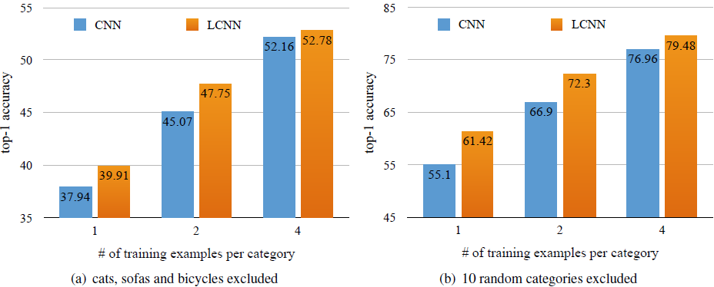
LCNN: Lookup-based Convolutional Neural Network, from Univ. of Washington
Propose a LCNN, which encodes convolutions by few lookups to a dictionary that is trained to cover the space of weights in CNNs.
Train LCNN by jointly learning a dictionary and a small set of linear combinations.
the procedure for constructing a weight filter in LCNN.
Based on Alexnet model

Slide 22
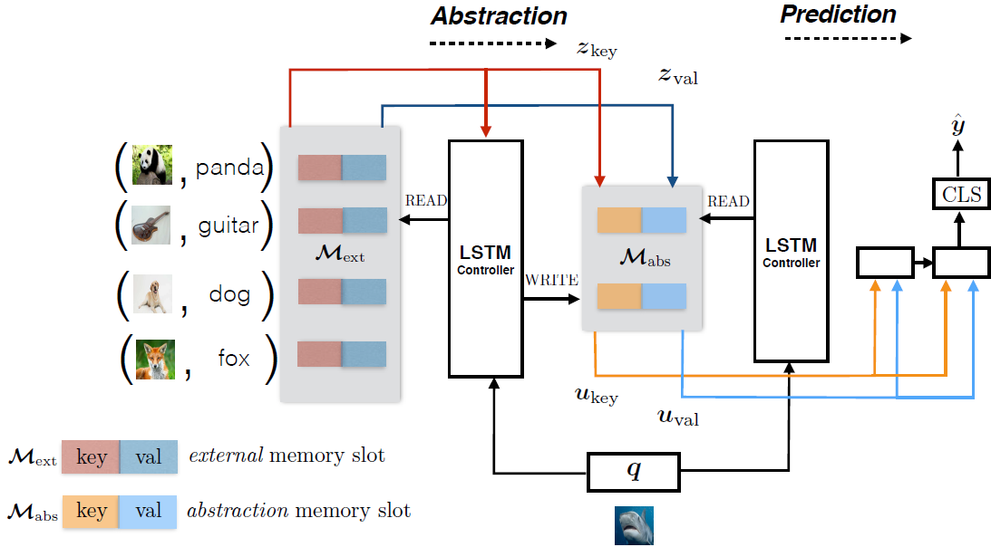
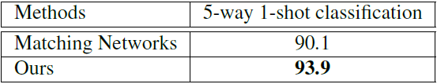
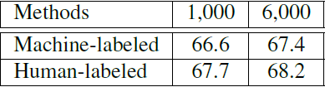
Few-Shot Object Recognition From Machine-Labeled Web Images, from Univ. of Tech. Sydney
Propose an “abstraction memory” based framework for few-shot learning, building upon machine labeled image annotations.
Utilize both visual embeddings and label embeddings in a form of key-value to make the system robust to imperfect labeling.
# of vocabulary
Results on the OpenImages dataset(100-way 5-shot）
Illustration of proposed method

Slide 23
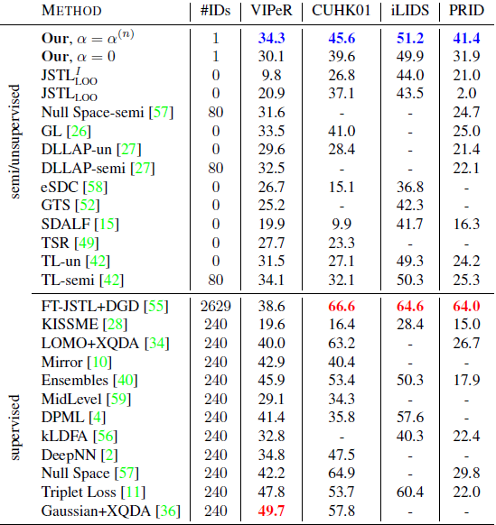
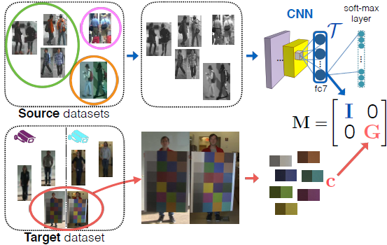
One-Shot Metric Learning for Person Re-Identification, from Disney
Split a metric for person re-identification into texture and color components.
Deep texture features are learned using only intensity images and adapt for color differences across cameras by learning a metric locally for patches using a single pair of images of a ColorChecker chart.
One-Shot Metric Learning

Slide 24
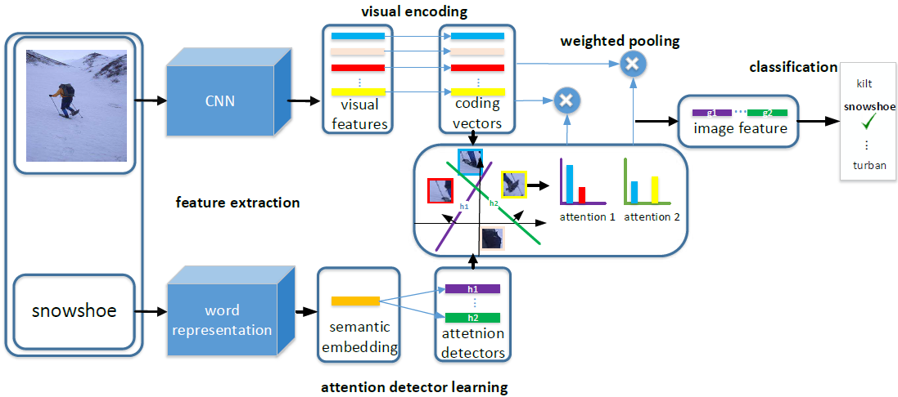
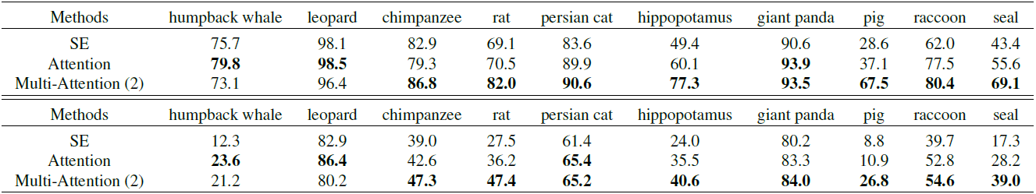
Multi-Attention Network for One Shot Learning, from Univ. of Adelaide
Show that class tag information can contribute one shot learning, and devise a novel method which is capable of exploiting this information.
Propose an attention network that can generate attention maps for creating the image representation of an exemplar image in novel class based on its class tag.
Comparison between supervised encoding and the proposed attention
network on the Animal Dataset
Architecture of the proposed attention network

Slide 25
Face related

Slide 26
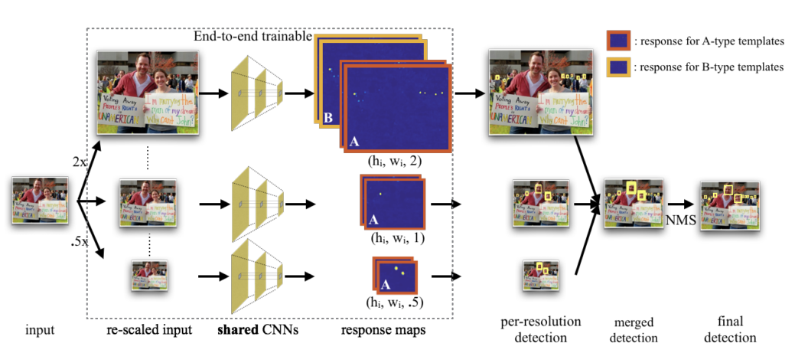
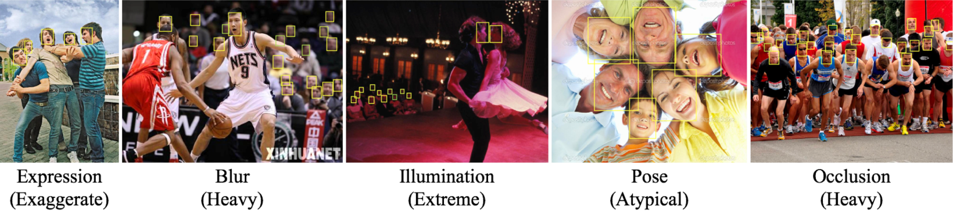
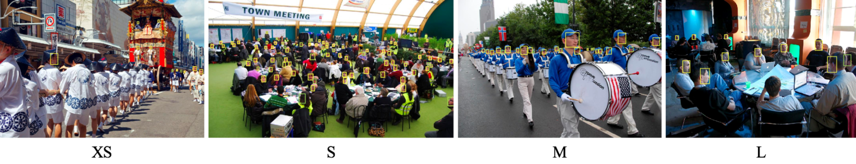
Find tiny faces, from CMU
Propose a novel approach to train separate face detectors for different scales.
Provide an in-depth analysis of image resolution, object scale, and spatial context for the purposes of finding small faces.
Overview of our detection pipeline

Slide 27
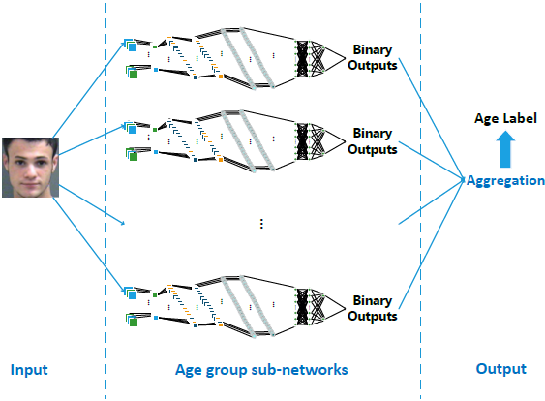
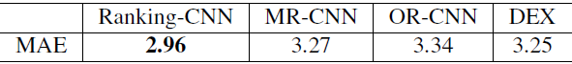
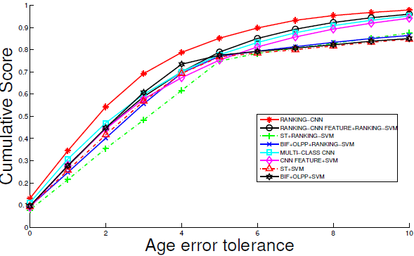
Using Ranking-CNN for Age Estimation, from Wayne State Univ.
Propose a novel CNN-based framework, ranking-CNN, for age estimation.
In ranking-CNN, we divide an age ranking estimation problem,ranging from 1, · · · ,K, into a series of binary classification sub-problems (K−1 classifiers).
Results on MORPH dataset
Ranking-CNN for facial image-based age estimation

Slide 28
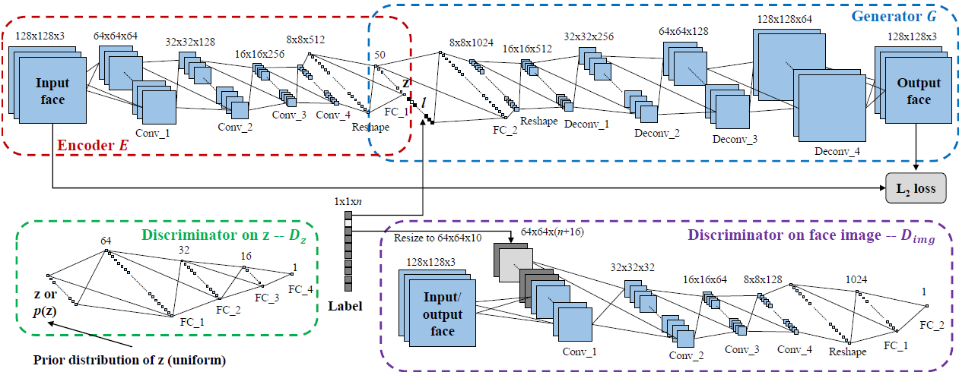
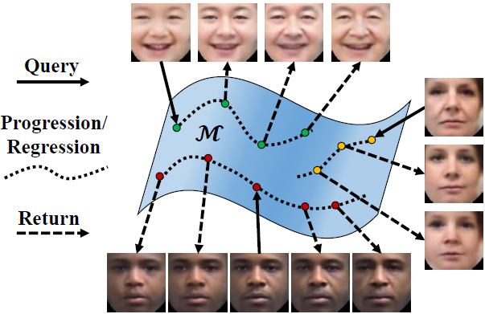
Age Progression/Regression by Conditional Adversarial Autoencoder, from Univ. of Tennessee
Proposed a novel conditional adversarial autoencoder (CAAE), which first achieves face age progression and regression in a holistic framework.
Mapped a face a latent vector through a convolutional encoder, and projected the vector to the face manifold conditional on age through a deconvolutional generator.
Assume the face images lie on a manifold (M)
Proposed CAAE network structure

Slide 29
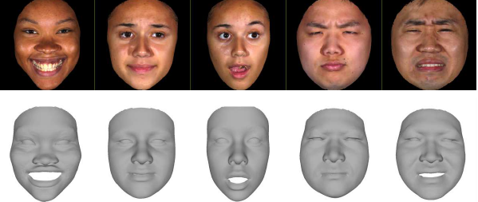
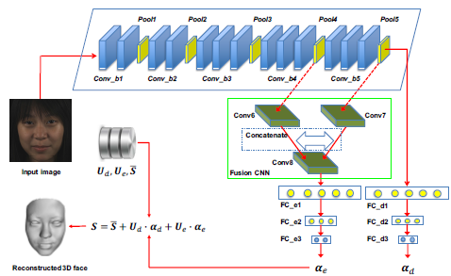
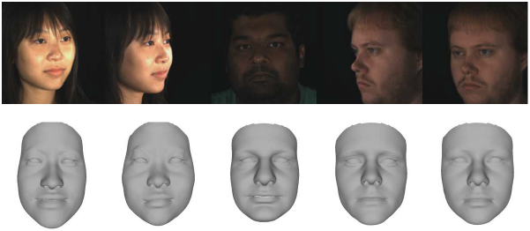
End-to-end 3D face reconstruction with deep neural networks, from Univ. of Houston
End-to-end approach takes only a single RGB image as input
Integrate in the DNN architecture two components, a multi-task loss function and a fusion convolutional neural network (CNN) to improve facial expression reconstruction.
Expressive 3D faces reconstructed from facial images with expression
Neutral 3D faces reconstructed from images with different facial pose
Network architecture

Slide 30
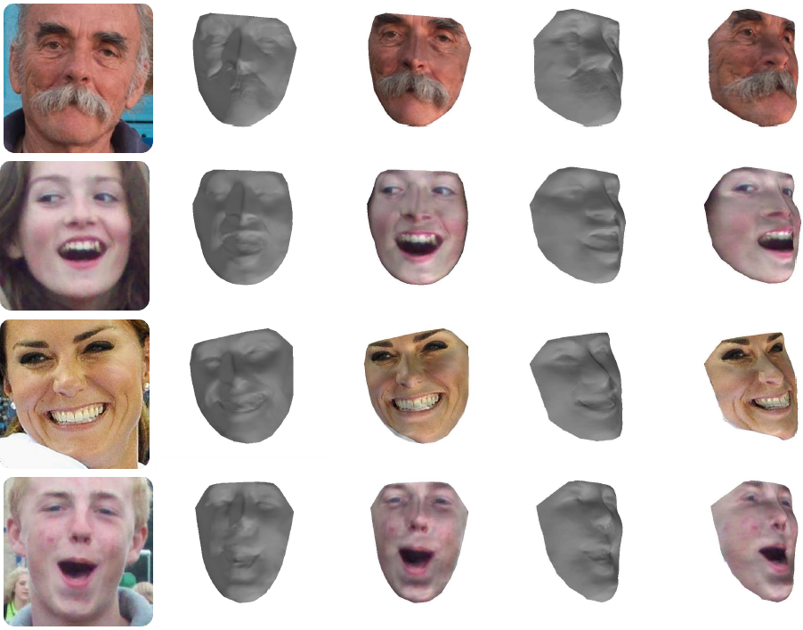
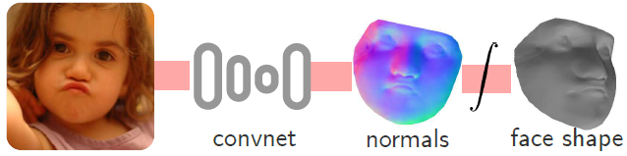
Face Normals “in-the-wild” using Fully Convolutional Networks, from Imperial College London
Propose new methods based on LSFM(large scale facial model) to exploit the currently available facial databases to construct training database
Propose discriminative methodology tailored to facial surface estimation “in-the-wild”
3D face shape estimation
Results on 300W dataset
3D shape reconstruction and the sampled texture from the image onto the shape

Slide 31
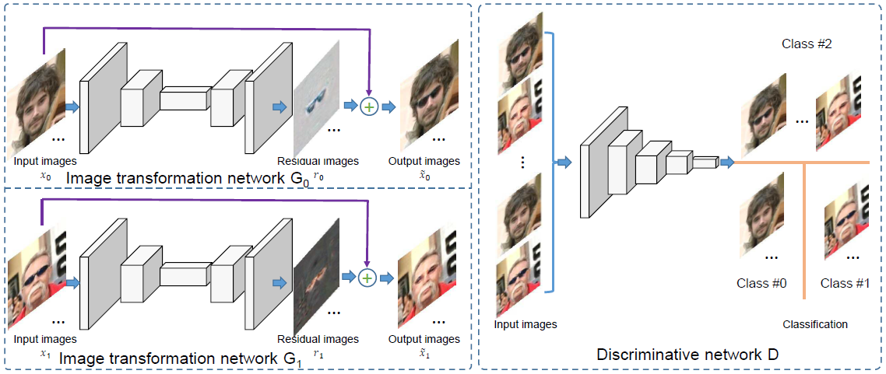
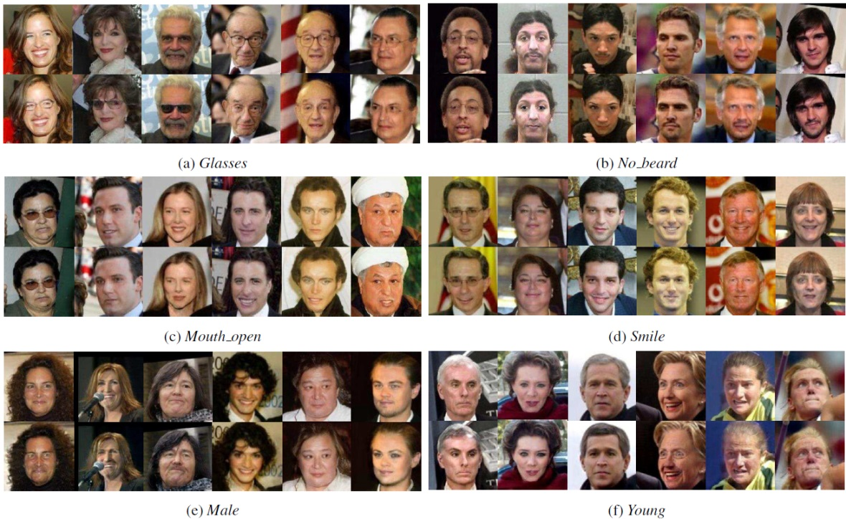
Learning Residual Images for Face Attribute Manipulation, from Fujitsu
Propose a GAN based approach for face attribute manipulation
Adopt both residual image learning and dual learning
The network consists of two image transformation networks and a discriminative network.
Architecture
Results

Slide 32
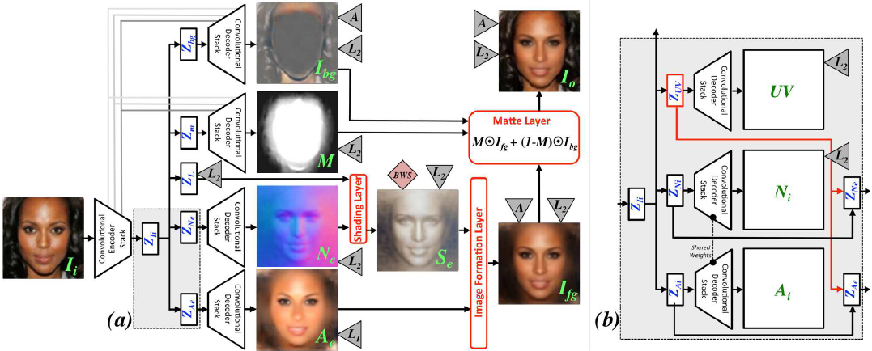
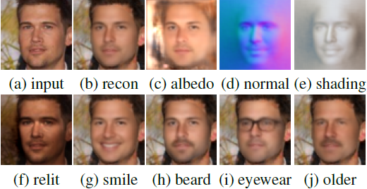
Neural Face Editing with Intrinsic Image Disentangling, from Stony Brook Univ.
Proposed an end-to-end GAN that infers a face-specific disentangled representation of intrinsic face properties, including shape (i.e. normals), albedo, and lighting, and an alpha matte.
Disentangling latent representation allows for semantically relevant edit of face image.
Network architecture

Slide 33



Disentangled Representation Learning GAN for Pose-Invariant Face Recognition, from Michigan State Univ.
Propose DR-GAN aiming for both representation learning and face synthesis.
DR-GAN has two variations: the basic model that takes one image as the input, termed as single-image DR-GAN, and the extended model that leverages multiple images per subject, termed as multi-image DR-GAN.
Benchmark comparison on Multi-PIE.
DR-GAN

Slide 34




Local Binary Convolutional Neural Networks, from CMU
Originate from LBP
learnable
Code:https://github.com/juefeix/lbcnn.torch

Slide 35


Local Binary Convolutional Neural Networks
Experimental results
Classification accuracy (%). LBCNN column only shows the best performing model and the Baseline column shows the particular CNN counterpart
Comparison of the number of learnable parameters in conv. layers in AlexNet and AlexNet with LBCNN modules. The proposed method saves 6.622× learnable parameters in the convolutional layers.

Slide 36
Action prediction

Slide 37


Deep Sequential Context Networks for Action Prediction, from Northeastern Univ.
Propose novel deep sequential context networks (DeepSCN) for action prediction
Reconstruct missing information in the features extracted from partial videos by learning from fully observed action videos
Given features extracted from a partially observed video, DeepSCN gains extra discriminative information from fully observed video. Multiple layers of learned features (purple nodes) are stacked to better abstract raw features.
Prediction results

Slide 38


On Human Motion Prediction Using Recurrent Neural Networks, from Univ. of British Columbia
Proposed a sequence-to-sequence architecture with residual connections to predict short-term human motions.
Moved from the usual multi-layer LSTM architectures to a single GRU.
Prediction
Ground truth
Architecture

Slide 39


Deep Representation Learning for Human Motion Prediction and Classification, from KTH
Proposed a deep learning framework that learns a generic representation(feature) from a large corpus of motion capture data and generalizes well to new, unseen, motions.
Demonstrated that the learned low-dimensional representation can be used for motion prediction and classification
Motion prediction error, general motion
The structure of three different temporal encoders
S-TE
C-TE
H-TE

Slide 40
Combine image & speech recognition technology

Slide 41


Lip Reading Sentences in the Wild, From Univ. of Oxford
Propose a novel approach to recognize phrases and sentences being spoken by a talking face, with or without the audio.
Architecture
Performance on the LRS test set.

